Slide 1

Operating Systems
BCSC 0004
Process Synchronization

Slide 2
Introduction of Process Synchronization
counter++ could be implemented as:
register1 = counter
register1 = register1 + 1
counter = register1
counter-- could be implemented as:
register2 = counter
register2 = register2 – 1
counter = register2
Consider this execution interleaving with “count = 5” initially:
S0: producer execute register1 = counter {register1 = 5}
S1: producer execute register1 = register1 + 1 {register1 = 6}
S2: consumer execute register2 = counter {register2 = 5}
S3: consumer execute register2 = register2 – 1 {register2 = 4}
S4: producer execute counter = register1 {counter = 6 }
S5: consumer execute counter = register2 {counter = 4}

Slide 3
Critical Section Problem
Consider system of n processes {p0, p1, … pn-1}
Each process has critical section segment of code
Process may be changing common variables, updating table, writing file, etc
When one process in critical section, no other may be in its critical section
Critical section problem is to design protocol to solve this
Each process must ask permission to enter critical section in entry section, may follow critical section with exit section, then remainder section
Critical section is a code segment that can be accessed by only one process at a time.
Critical section contains shared variables which need to be synchronized to maintain consistency of data variables.

Slide 4
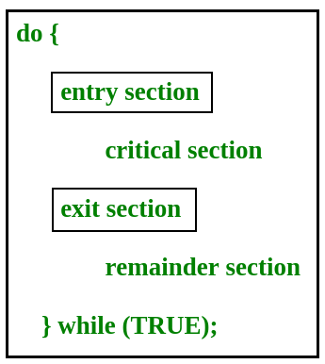
Critical Section Problem

Slide 5
Critical Section Problem
Any solution to the critical section problem must satisfy three requirements:
Mutual Exclusion: If a process is executing in its critical section, then no other process is allowed to execute in the critical section.
Progress : If no process is executing in the critical section and other processes are waiting outside the critical section, then only those processes that are not executing in their remainder section can participate in deciding which will enter in the critical section next, and the selection cannot be postponed indefinitely.
Bounded Waiting: A bound must exist on the number of times that other processes are allowed to enter their critical sections after a process has made a request to enter its critical section and before that request is granted.

Slide 6
Two process solution for critical section
First Solution: Boolean turn=0;
 | P₀ | P₁
 | while(1) { While(turn!=0); Turn=1; Remainder Section } | while(1) { While(turn!=1); Turn=0; }
Critical Section
Critical Section
Remainder Section
Remainder Section

Slide 7
Solution first is following Mutual Exclusion and fails to follow Progress as both process spin in some order that is both process can be executed one by one. Any Process P0 or P1 cannot be executed two times sequentially.

Slide 8
Two process solution for critical section
F | F
0 | 1
Second Solution: Boolean Flag[2]=
 | P₀ | P₁
 | while(1) { Flag[0]= T; while(flag[1]); flag[0]=F; } | while(1) { Flag[1]= T; while(flag[0]); flag[1]=F; }
Critical Section
Critical Section
Remainder Section
Remainder Section

Slide 9
Peterson’s Solution
Peterson’s Solution is a classical software based solution to the critical section problem.
In Peterson’s solution, we have two shared variables:
  boolean flag[i]: Initialized to FALSE, initially no one is interested in entering the critical section
  int turn : The process whose turn is to enter the critical section.

Slide 10
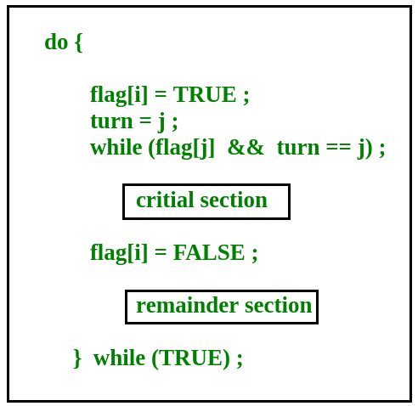
Peterson’s Solutions
i = 1-j

Slide 11

Two process solution for critical section
F | F
0 | 1
Second Solution: Boolean Flag[2]=
 | P₀ | P₁
 | while(1) { Flag[0]= T; Turn=1; while(turn==1 &&flag[1]==T); flag[0]=F; } | while(1) { Flag[1]= T; Turn=0 while(turn==0 &&flag[0]==T); flag[1]=F; }
Critical Section
Critical Section
Remainder Section
Remainder Section

Slide 12


